Slide 1
Unit 4
Tuning For Data Warehouse(DWH)

Slide 2
Tuning For Data WareHouse
The process of applying different strategies in performing different operations of data warehouse such that performance measures will enhance is called data warehousing tuning.
Aspects of a data warehouse such as performance, data load, queries evaluations etc.
Tuning a data warehouse is a difficult procedure due to following reasons:
Data warehouse is dynamic; it never remains constant.
It is very difficult to predict what query the user is going to post in the future.
Business requirements change with time.
Users and their profiles keep changing.
The user can switch from one group to another.
The data load on the warehouse also changes with time.

Slide 3
7 Ways to Improve Performance of DWH
1. Indexing
Adding some search functionality or indexes can drastically improve your chances of finding your item quicker.
Indexes store the value from the given column in a searchable structure, which allows the query to read less data to find the information.
2. Compression
If you have a row simply for the value of “Y” & “N”, and the data type is Char(1000), there is no usage of all those bytes.
Compressing it saves that much space in the disk without compromising the output of your queries.
3. Collecting Statistics
It is essential to collect stats on columns frequently used downstream for joining, aggregating or ordering.

Slide 4
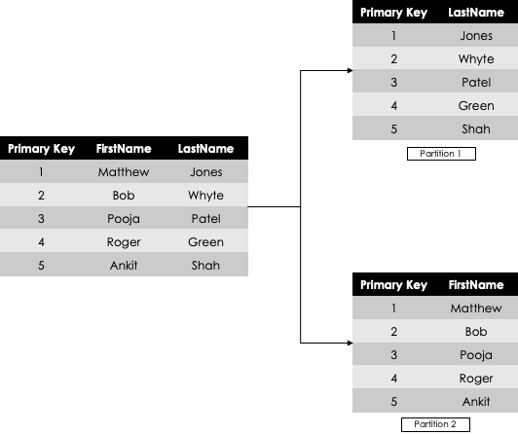
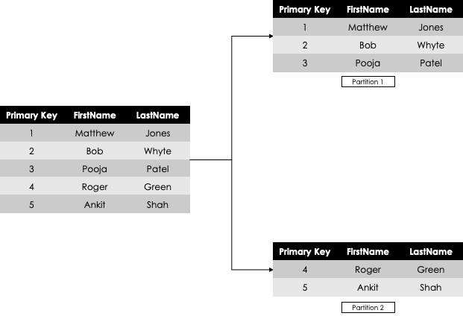
4. Creating Building Blocks and Views
Instead of directly going to the underlying data table, it is advisable to perform some pre-aggregation for your most used queries in a building block or a view.
5. Partitioning & Sharding
Partitioning is logically dividing up large tables into smaller, manageable chunks. Since the table is now in smaller chunks, the overall query runs quicker as it has to scan less data.
Partitioning, also called “vertical partitioning” and Horizontal Partitioning, also known as “Sharding”.

Slide 5
6. Query Optimization
The execution plan you choose in DWH technology will also offer valuable insights into improving query performance.
7. Data Minimization
Collect only the necessary data and store it in data warehouse to answer the business questions.

Slide 6
Data Generalization
Data generalization is the process of creating a more broad categorization of data in a database, essentially ‘zooming out’ from the data to create a more general picture of trends or insights it provides.
Original Data:
Ages: 26, 28, 31, 33, 37, 42, 42, 46, 48, 49, 54, 57, 57, 58, 59
It replaces a specific data value with one that is less precise.
It is widely applicable and used technique in data mining, analysis, and secure storage.
Generalized Data:
Ages:
20-29 (2)
30-39 (3)
40-49 (5)
50-59 (5)

Slide 7
Data Generalization → Why it is needed?
when you need to analyze data that you’ve collected, but also need to ensure the privacy of the individuals who are included in that data.
It’s a powerful way of abstracting personal information while retaining the usefulness of the data points.
In the age example above, generalizing age data based on each decade gives a general picture of where the individuals in the data set fall, and still allows you to use that data for relatively accurate targeting or analysis.

Slide 8
Data Cube: A Lattice of Cuboids
all
0-D(apex) cuboid
time
item
location
supplier
1-D cuboids
time,location
item,location
location,supplier
2-D cuboids
time,item
time,supplier
item,supplier
time,location,supplier
3-D cuboids
time,item,location
time,item,supplier
item,location,supplier
4-D(base) cuboid
time, item, location, supplierc
8

Slide 9
Data Warehouse Implementation
Data warehouses contain huge volumes of data. OLAP servers demand that decision support queries be answered in the order of seconds.
Therefore, it is crucial for data warehouse systems to support highly efficient cube computation techniques, access methods, and query processing techniques
1. Efficient Computation of Data Cubes
At the core of multidimensional data analysis is the efficient computation of aggregations across many sets of dimensions.
In SQL terms, these aggregations are referred to as group-by’s. Each group-by can be represented by a cuboid, where the set of group-by’s forms a lattice of cuboids defining a data cube

Slide 10
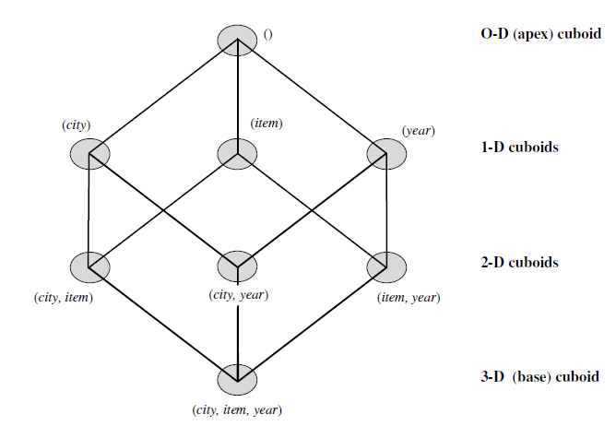
The compute cube Operator
The compute cube operator computes aggregates over all subsets of the dimensions specified in the operation.
This can require excessive storage space, especially for large numbers of dimensions.
Suppose that you would like to create a data cube for AllElectronics sales that contains the following: city, item, year, and sales in dollars. You would like to be able to analyze the data, with queries such as the following:
“Compute the sum of sales, grouping by city and item.”
“Compute the sum of sales, grouping by city.”
“Compute the sum of sales, grouping by item.”

Slide 11
What is the total number of cuboids, or group-by’s, that can be computed for this data cube?
Taking the three attributes, city, item, and year, as the dimensions for the data cube, and sales in dollars as the measure, the total number of cuboids, or group by’s, that can be computed for this data cube is 2³ = 8.
The possible group-by’s are the following: {(city, item, year), (city, item), (city, year), (item, year), (city), (item), (year), ()} where () means that the group-by is empty (i.e., the dimensions are not grouped).
The base cuboid contains all three dimensions, city, item, and year. It can return the total sales for any combination of the three dimensions.
The apex cuboid, or 0-D cuboid, refers to the case where the group-by is empty. It contains the total sum of all sales. The base cuboid is the least generalized (most specific) of the cuboids.

Slide 12
Similar to the SQL syntax, the data cube could be defined as
define cube sales cube [city, item, year]: sum(sales in dollars)
For a cube with n dimensions, there are a total of 2^{n} cuboids, including the base cuboid.
A statement such as
compute cube sales cube
would explicitly instruct the system to compute the sales aggregate cuboids for all of the eight subsets of the set {city, item, year}, including the empty subset

Slide 13
Curse of Dimensionality
On-line analytical processing may need to access different cuboids for different queries.
Therefore, it may seem like a good idea to compute all or at least some of the cuboids in a data cube in advance.
Pre-computation leads to fast response time and avoids some redundant computation.
A major challenge related to this pre- computation, however, is that the required storage space may explode if all of the cuboids in a data cube are pre-computed, especially when the cube has many dimensions.
The storage requirements are even more excessive when many of the dimensions have associated concept hierarchies, each with multiple levels. This problem is referred to as the curse of dimensionality.

Slide 14

How many cuboids are there in an n-dimensional data cube?”
If there were no hierarchies associated with each dimension, then the total number of cuboids for an n-dimensional data cube, as we have seen above, is 2^{n}.
However, in practice, many dimensions do have hierarchies. For example, the dimension time is usually not explored at only one conceptual level, such as year, but rather at multiple conceptual levels, such as in the hierarchy “day < month < quarter < year”.
For an n-dimensional data cube, the total number of cuboids that can be generated is
where L_{i} is the number of levels associated with dimension i
If the cube has 10 dimensions and each dimension has 4 conceptual levels, What will be the number of cuboids generated?
Total number of cuboids=5¹⁰ = 9.8*10⁶

Slide 15
Partial Materialization: Selected Computation of Cuboids
Materialized views can be used to pre-compute and store aggregated data such as sum of sales.
Materialized views in these environments are typically referred to as summaries since they store summarized data.
If there are many cuboids, and these cuboids are large in size, a more reasonable option is partial materialization, that is, to materialize only some of the possible cuboids that can be generated.
There are three choices for data cube materialization given a base cuboid
1. No materialization: Do not pre-compute any of the “non base” cuboids. This leads to computing expensive multidimensional aggregates, which can be extremely slow.

Slide 16
2. Full materialization: Pre-compute all of the cuboids. The resulting lattice of computed cuboids is referred to as the full cube. This choice typically requires huge amounts of memory space in order to store all of the pre-computed cuboids.
3. Partial materialization: We may compute a subset of the cube, which contains only those cells that satisfy some user-specified criterion, such as where the tuple count of each cell is above some threshold.
The partial materialization of cuboids or sub cubes should consider three factors:
identify the subset of cuboids or sub cubes to materialize;
exploit the materialized cuboids or sub cubes during query processing;
efficiently update the materialized cuboids or sub cubes during load and refresh.

Slide 17
2. Access Methods: Indexing OLAP Data
To facilitate efficient data accessing, most data warehouse systems support index structures and materialized views.
Techniques are bitmap indexing and join indexing.
1.Bitmap indexing
The bitmap indexing method is popular in OLAP products because it allows quick searching in data cubes.
In the bitmap index for a given attribute, there is a distinct bit vector, Bv, for each value v in the domain of the attribute.
If the domain of a given attribute consists of n values, then n bits are needed for each entry in the bitmap index (i.e., there are n bit vectors).
If the attribute has the value v for a given row in the data table, then the bit representing that value is set to 1 in the corresponding row of the bitmap index.
All other bits for that row are set to 0.

Slide 18
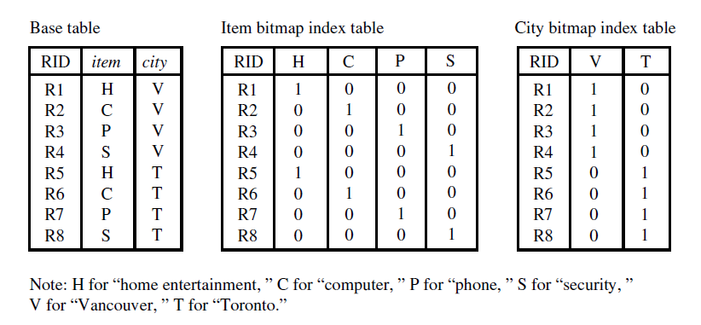
In the AllElectronics data warehouse, suppose the dimension item at the top level has four values (representing item types): “home entertainment,” “computer,” “phone,” and “security.”

Slide 19
2.Join Indexing
In contrast, join indexing registers the joinable rows of two relations from a relational database.
For example, if two relations R(RID, A) and S(B, SID) join on the attributes A and B, then the join index record contains the pair (RID, SID), where RID and SID are record identifiers from the R and S relations, respectively.
Join indexing is especially useful for maintaining the relationship between a foreign key and its matching primary keys, from the joinable relation.
The star schema model of data warehouses makes join indexing attractive for cross table search, because the linkage between a fact table and its corresponding dimension tables comprises the foreign key of the fact table and the primary key of the dimension table.

Slide 20
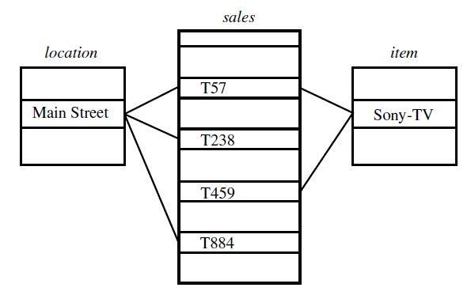
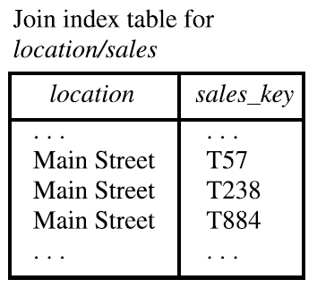
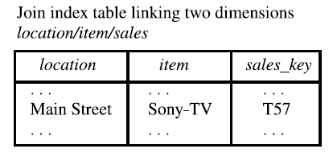
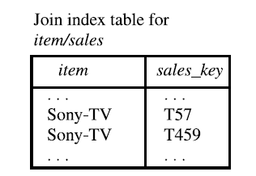
Linkages between a sales fact table and dimension tables for location and item.

Slide 21
3.Efficient Processing of OLAP Queries
Determine which operations should be performed on the available cuboids:
2. Determine to which materialized cuboid(s) the relevant operations should be applied:
OLAP query processing. Suppose that we define a data cube for AllElectronics of the form
“sales cube [time, item, location]: sum(sales in dollars)”.
The dimension hierarchies used
are “day < month < quarter < year” for time, “item name < brand < type” for item, and
“street < city < province or state < country” for location.
Suppose that the query to be processed is on {brand, province or state}, with the
selection constant “year = 2004”.
Also, suppose that there are four materialized cuboids available, as follows:
cuboid 1: {year, item name, city}
cuboid 2: {year, brand, country}
cuboid 3: {year, brand, province or state}
cuboid 4: {item name, province or state} where year = 2004
Which of the above four cuboids should be selected to process the query?”
Cuboid 2 cannot be used because country is a more general concept than province or state.
Cuboids 1, 3, and 4 can be used to process the query

Slide 22
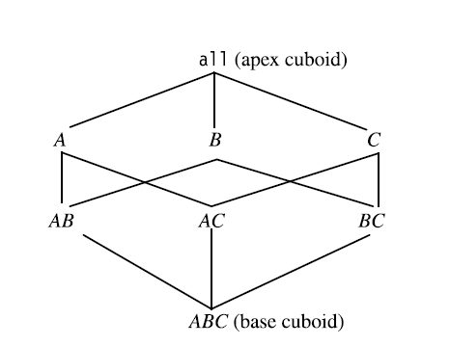
Cube Materialization
How can we compute data cubes in advance, so that they are handy and readily available for
query processing?”
Figure shows a 3-D data cube for the dimensions A, B, and C, and an aggregate measure, M.
Commonly used measures include count() , sum() , min() , max() , and total sales().
Each cuboid represents a group-by.
ABC is the base cuboid, containing all three of the dimensions. Here, the aggregate measure, M, is computed for each possible combination of the three dimensions.

Slide 23
Cube Materialization → Base and aggregate cells
A cell in the base cuboid is a base cell.
A cell from a non-base cuboid is an aggregate cell.
An aggregate cell aggregates over one or more dimensions, where each aggregated dimension is indicated by a * in the cell notation.
Suppose we have an n-dimensional data cube. Let a = (a1, a2, : : : , an, measures) be a cell from one of the cuboids making up the data cube.
We say that a is an m-dimensional cell (that is, from an m-dimensional cuboid) if exactly m (m <= n) values among {a1, a2, : : : , an} are not “* ”.
If m = n, then a is a base cell; otherwise, it is an aggregate cell (i.e., where m < n).

Slide 24
Base and aggregate cells:-
Consider a data cube with the dimensions month, city, and customer group, and the measure price. (Jan, *, * , 2800) and (*, Toronto, * , 1200) are 1-D cells, (Jan, * , Business, 150) is a 2-D cell, and (Jan, Toronto, Business, 45) is a 3-D cell.
Here, all base cells are 3-D, whereas 1-D and 2-D cells are aggregate cells
An ancestor-descendant relationship may exist between cells.
Referring to our previous example, 1-D cell
a=(Jan, * , * , 2800), and 2-D cell b = (Jan, * , Business, 150), are ancestors of 3-D cell c = (Jan, Toronto, Business, 45); c is a descendant of both a and b; b is a parent of c, and c is a child of b.

Slide 25
Cube Materialization → Full Cube
All the cells of all the cuboids for a given data cube is full cube.
To ensure fast OLAP, it is sometimes desirable to pre-compute the full cube.
Pre-computation of the full cube can require huge and often excessive amounts of memory.

Slide 26
Cube Materialization → Sparse Cube
Many cells in a cuboid may actually be of little or no interest to the data analyst.
Recall that each cell in a full cube records an aggregate value. Measures such as count, sum, or sales in dollars are commonly used.
For many cells in a cuboid, the measure value will be zero.
When the product of the cardinalities for the dimensions in a cuboid is large relative to the number of nonzero-valued tuples that are stored in the cuboid, then we say that the cuboid is sparse.
If a cube contains many sparse cuboids, we say that the cube is sparse.
A substantial amount of the cube’s space could be taken up by a large number of cells with very low measure values.

Slide 27
Cube Materialization → Iceberg Cube
An Iceberg-Cube contains only those cells of the data cube that meet an aggregate condition.
It is called an Iceberg-Cube because it contains only some of the cells of the full cube, like the tip of an iceberg.
The aggregate condition could be, for example, minimum support or a lower bound on average, min or max.
The purpose of the Iceberg-Cube is to identify and compute only those values that will most likely be required for decision support queries.
The minimum threshold is called the minimum support threshold, or minimum support(min sup)
In a data cube for sales, say, we may wish to materialize only those cells for which count <= 10 or only those cells representing sales$>= 100.
This not only saves processing time and disk space, but also leads to a more focused analysis.
compute cube sales iceberg as
select month, city, customer group, count(*)
from salesInfo
cube by month, city, customer group
having count(*) >= min sup
Constraint specified in the having clause is known as
the iceberg condition

Slide 28
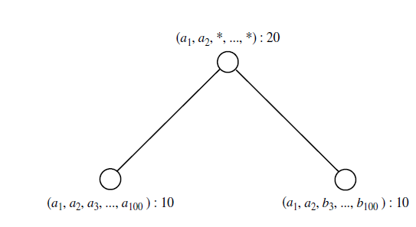
Cube Materialization → Closed Cube
A cell, c, is a closed cell if there exists no cell, d, such that d is a specialization (descendant) of cell c (that is, where d is obtained by replacing a * in c with a non- * value), and d has the same measure value as c.
A closed cube is a data cube consisting of only closed cells.

Slide 29
Cube Materialization → Cube Shell
Another strategy for partial materialization is to pre-compute only the cuboids involving a small number of dimensions, such as 3 to 5.

Slide 30
General Strategies for Cube Computation
Optimization Technique 1: Sorting, hashing, and grouping. Sorting, hashing, and grouping operations should be applied to the dimension attributes in order to reorder and cluster related tuples.
Optimization Technique 2: Simultaneous aggregation and caching intermediate results.
Optimization Technique 3: Aggregation from the smallest child, when there exist multiple child cuboids.
Optimization Technique 4: The Apriori pruning method can be explored to compute iceberg cubes efficiently. “If a given cell does not satisfy minimum support, then no descendant of the cell will satisfy minimum support either”.

Slide 31
Data Cube Computation Methods
1. Multi-way Array Aggregation (Multi-Way)
2. Bottom-Up Computation (BUC)
3. Star-Cubing
4. High dimension OLAP

Slide 32
Multi-Way Array Aggregation
Multi-Way method computes a full data cube by using a multidimensional array as its basic data structure.
It is a typical MOLAP approach that uses direct array addressing, where dimension values are accessed via the position or index of their corresponding array locations.
A different approach is developed for the array-based cube construction, as follows:
a)Partition the array into chunks.
Chunking is a method for dividing an n-dimensional array into small n-dimensional chunks, where each chunk(sub cube) is stored as an object on disk.
b)Compute aggregates by visiting cube cells.
The order in which cells are visited can be optimized so as to minimize the number of times that each cell must be revisited, thereby reducing memory access and storage costs.
It performs simultaneous aggregation—that is, it computes aggregations simultaneously on multiple dimensions.

Slide 33
Multi-way Array Aggregation for Cube Computation
Consider a 3-D data array containing the three dimensions A, B, and C.
The 3-D array is partitioned into small, memory-based chunks.
In this example, the array is partitioned into 64 chunks.
Dimension A is organized into four equal-sized partitions, a0, a1, a2, and a3. Dimensions B and C are similarly organized into four partitions each.
C
c3
61
62
63
64
c2
45
46
47
48
c1
29
30
31
32
What is the best traversing order to do multi-way aggregation?
c 0
B
60
b3
13
14
15
16
44
9
28
56
b2
B
40
24
52
b1
5
36
20
b0
1
2
3
4
a0
a1
a2
a3
A

Slide 34
Multi-way Array Aggregation (3-D to 2-D)
Suppose that the cardinality of the dimensions A, B, and C is 40, 400, and 4000, respectively. Thus, the size of the array for each dimension, A, B, and
C, is also 40, 400, and 4000,
respectively.

Slide 35
Multi-way Array Aggregation (2-D to 1-D)

Slide 36
The resulting full cube consists of the following cuboids:
The base cuboid, denoted by ABC (from which all of the other cuboids are directly or indirectly computed). This cube is already computed and corresponds to the given 3-D array.
The 2-D cuboids, AB, AC, and BC, which respectively correspond to the group-by’s AB, AC, and BC. These cuboids must be computed.
The 1-D cuboids, A, B, and C, which respectively correspond to the group-by’s A, B, and C. These cuboids must be computed.
The 0-D (apex) cuboid, denoted by all, which corresponds to the group-by (); that is, there is no group-by here. This cuboid must be computed. It consists of one value. If, say, the data cube measure is count, then the value to be computed is simply the total count of all of the tuples in ABC.

Slide 37
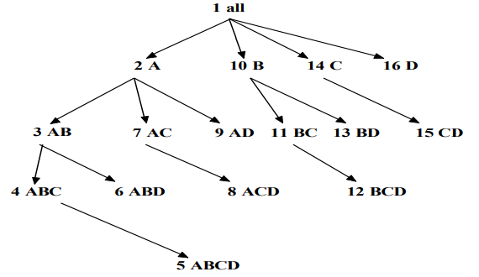
Bottom Up Computation (BUC)
BUC is an algorithm for the computation of sparse and iceberg cubes.
Unlike Multi-Way, BUC constructs the cube from the apex cuboid toward the base cuboid. This allows BUC to share data partitioning costs.
The BUC is viewed as lattice of cuboids in the reverse order, with the apex cuboid at the bottom and the base cuboid at the top. In that view, BUC does bottom-up construction.

Slide 38
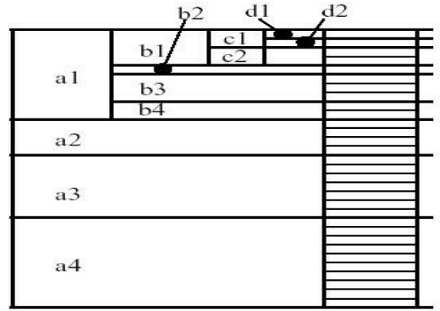
BUC: Partitioning and Aggregating
Suppose (a1,∗,∗,∗) satisfies the minimum support, in which case a recursive call is made on the partition for a1.
BUC partitions a1 on the dimension B. It checks the count of (a1,b1,∗,∗) to see if it satisfies the minimum support.
If it does, it outputs the aggregated tuple to the AB group-by and recurses on (a1,b1,∗, ∗) to partition on C, starting with c1. Suppose the cell count for (a1,b1,c1,∗) is 2, which does not satisfy the minimum support. According to the Apriori property, if a cell does not satisfy the minimum support, then neither can any of its descendants. Therefore, BUC prunes any further exploration of (a1,b1,c1,∗). That is, it avoids partitioning this cell on dimension D. It backtracks to the a1,b1 partition and recurses on (a1,b1,c2,∗), and so on

Slide 39
Efficient Methods → Star-Cubing
It integrates top-down and bottom-up cube computation and explores both multidimensional aggregation .
It operates from a data structure called a star-tree, which performs lossless data compression, thereby reducing the computation time and memory requirements.
Explores both the bottom-up and top-down computation models as follows:
- On the global computation order, it uses the bottom-up model.
- For exploring the dimension, top-down model is used.

Slide 40
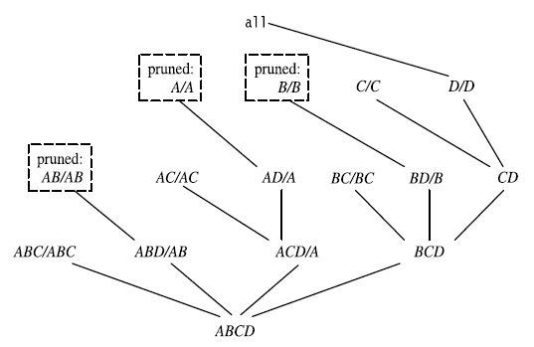
Explore shared dimensions
- Dimension A is the shared dimension of ACD and AD
- ABD/AB means cuboid ABD has shared dimensions AB

Slide 41
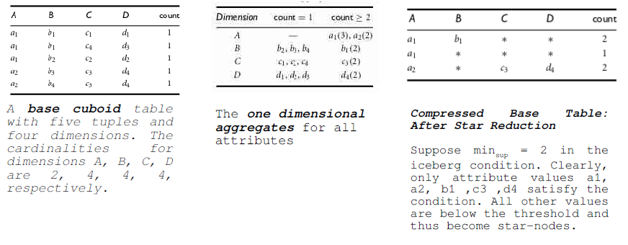
Star Tree Construction

Slide 42
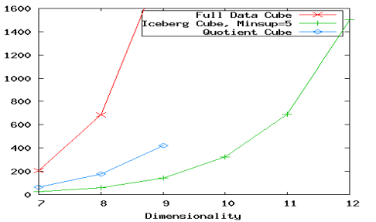
High-Dimensional OLAP
High-D OLAP: Needed in many applications
✗ Science and engineering analysis
✗ Bio-data analysis: thousands of genes
✗ Statistical surveys: hundreds of variables
● None of the previous cubing method can handle high dimensionality!
✗ Iceberg cube and compressed cubes:
only delay the inevitable(certain to happen) explosion
✗ Full materialization: still significant overhead in accessing results on disk

Slide 43
Fast High-D OLAP with Minimal Cubing
Observation
OLAP occurs only on a small subset of dimensions at a time
Semi-Online Computational Model
1. Partition the set of dimensions into shell fragments
2. Compute data cubes for each shell fragment while retaining inverted indices or value-list indices
3. Given the pre-computed fragment cubes, dynamically compute cube cells of the high dimensional data cube online

Slide 44
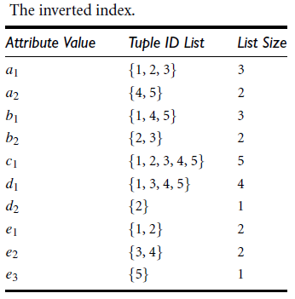
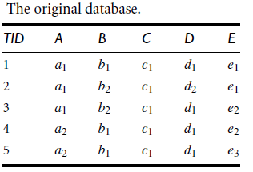
Shell Fragment
The shell fragment approach can handle databases of extremely high dimensionality and can quickly compute small local cubes on-line.
It explores the inverted index data structure, which is popular in information retrieval and Web-based information systems.
The basic idea is as follows. Given a high-dimensional data set, we partition the dimensions into a set of disjoint dimension fragments, convert each fragment into its corresponding inverted index representation, and then construct shell fragment cubes while keeping the inverted indices associated with the cube cells.

Slide 45
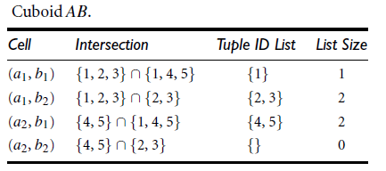
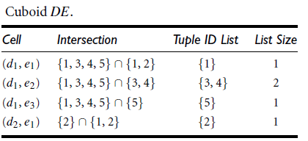
Compute shell fragments
Suppose we are to compute the shell fragments of size 3.
We first divide the five dimensions into two fragments, namely
(A, B, C) and (D, E).
For example, to compute the cell
(a1, b2, *), we intersect the tuple ID lists of a1 and b2 to obtain a new list of {2, 3}.

